Slide 1

CORONA VIRUS ANALYSIS WITH SQL
Mentorness
Internship project by
Priyanshu bhatia
Batch Name: MIP-DA-07

Slide 2

CONTENT
Project Overview
Data Description
Analysis (Queries)
Summary

Slide 3

PROJECT OVERVIEW
Analyzing a Corona Virus dataset using "Corona_virus_dataset" table is necessary to "comprehend Coronavirus." Its goal is to gather information about impacted and recovered cases. Our goal is to comprehend the global impact of the coronavirus using SQL queries.
Important queries include which country is most and least impacted by the coronavirus, how long ago occurrence occurred , and all the details regarding confirmed ,recovered and fatal cases. Our objective is to offer practical insights so that future decisions can be made with knowledge.
The project encompasses data explorations , query formulation , result interpretation and data visualization techniques. Through concise presentation

Slide 4
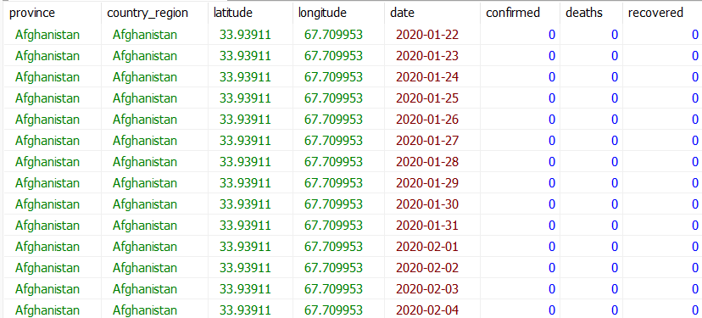
DATA DESCRIPTION The dataset include 1 table: “Corona_Virus_Dataset”
“Corona_Virus_dataset”
Province
Country_region
Latitude
Longitude
Date
Confirmed
Deaths
Recovered

Slide 5
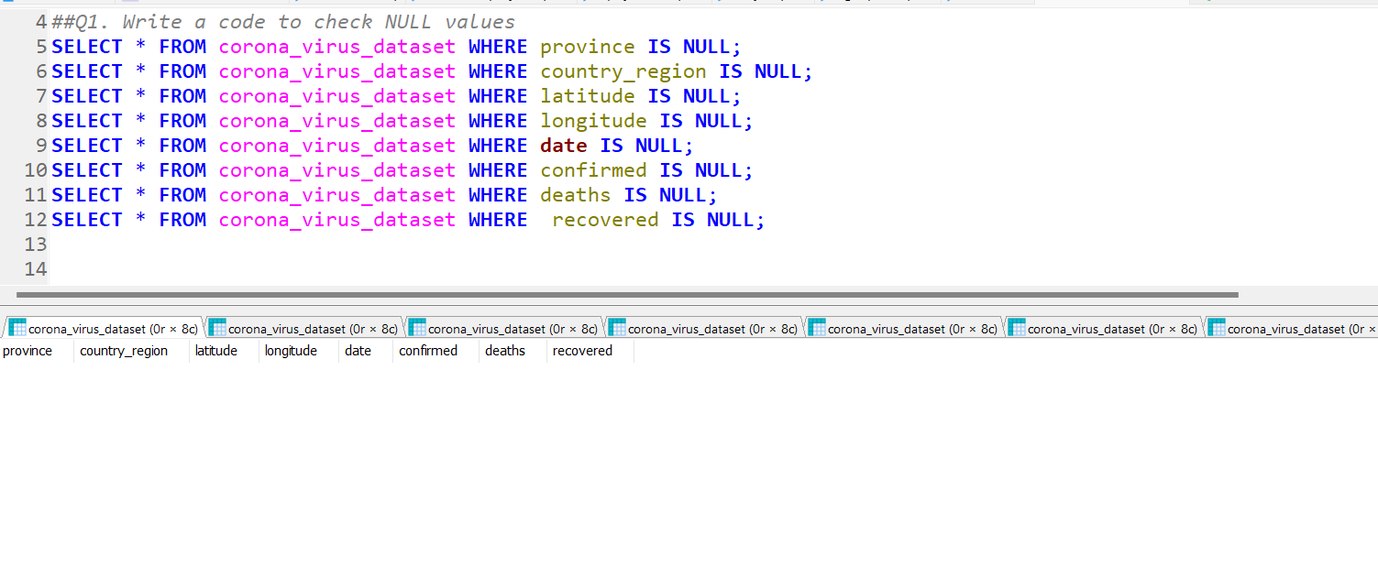
Analysis:-
To find the NULL values in the coronavirus table, it employs the IS NULL logical operators.
The result is that there is no NULL values present in the corona_virus_dataset.

Slide 6
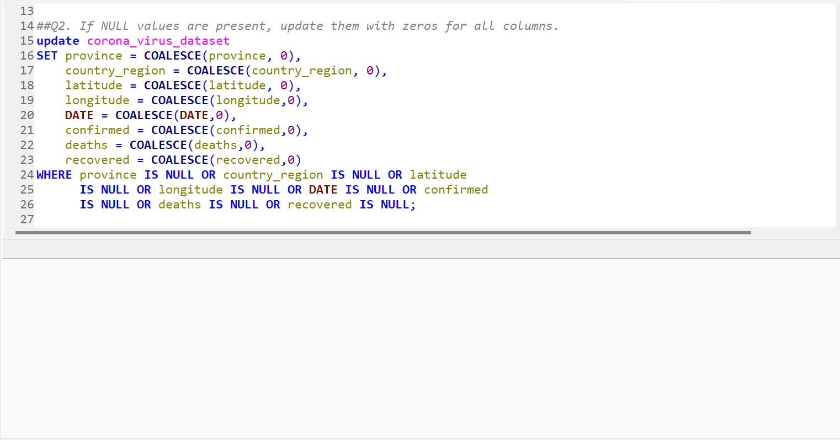
Analysis:-
It performs COALESCE function to replace the NULL values with Zeros present in the corona_virus_dataset table.
The result is that there is none NULL values present in the corona_virus_dataset that should be replaced with zeros.

Slide 7
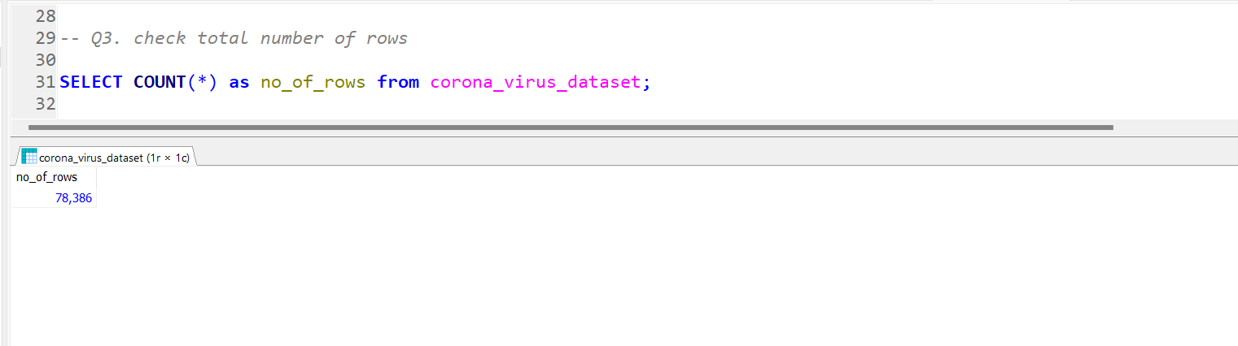
Analysis:-
It counts the number of rows present in the corona_virus_dataset using the COUNT function that is a logical operator in SQL.
It clears show that there are 78,386 number of rows present in the corona_virus_dataset table.

Slide 8
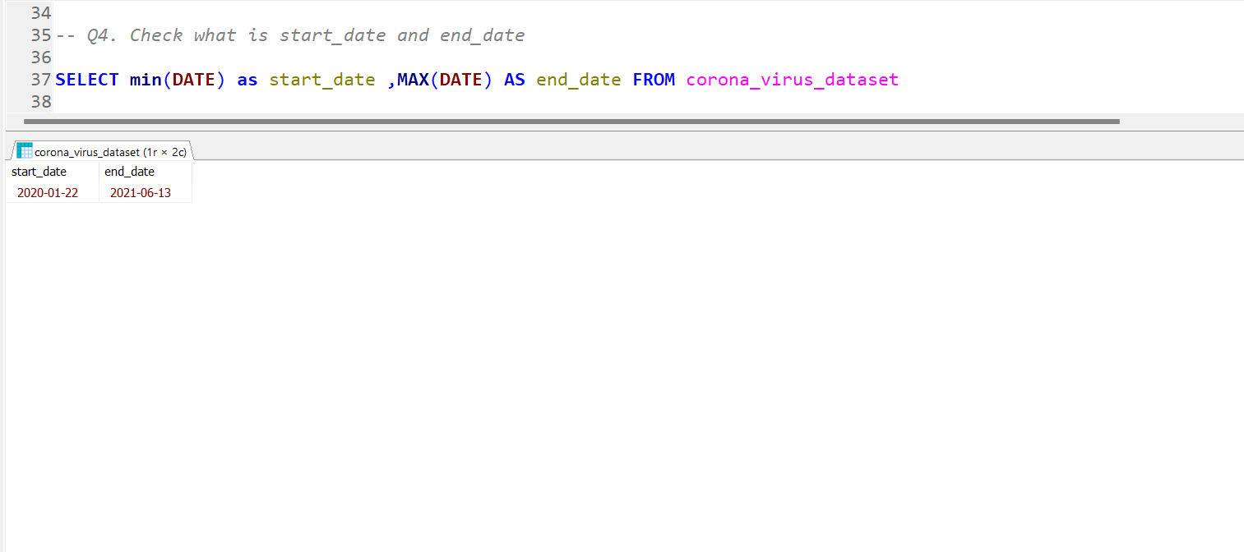
Analysis:-
It will extract the start_date and end_date of the date column in the corona_virus_dataset table using the MIN() and MAX() functions. Now, it will showcase the start_date as 2020-01-22 and end_date as 2021-06-13 as the record of the coronavirus cases occurred in the period of time.

Slide 9
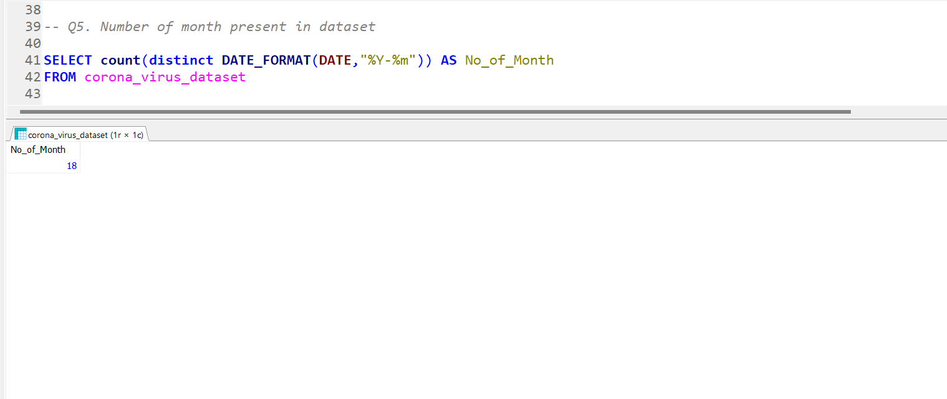
Analysis:-
The months are extracted from the date column in the table using the DATE_FORMAT method , the COUNT function,and the DISTINCT function in the SQL query. DISTINCT will extract only the unique values from the date column .The number of months included in the corona_virus_dataset will be retrieved.

Slide 10
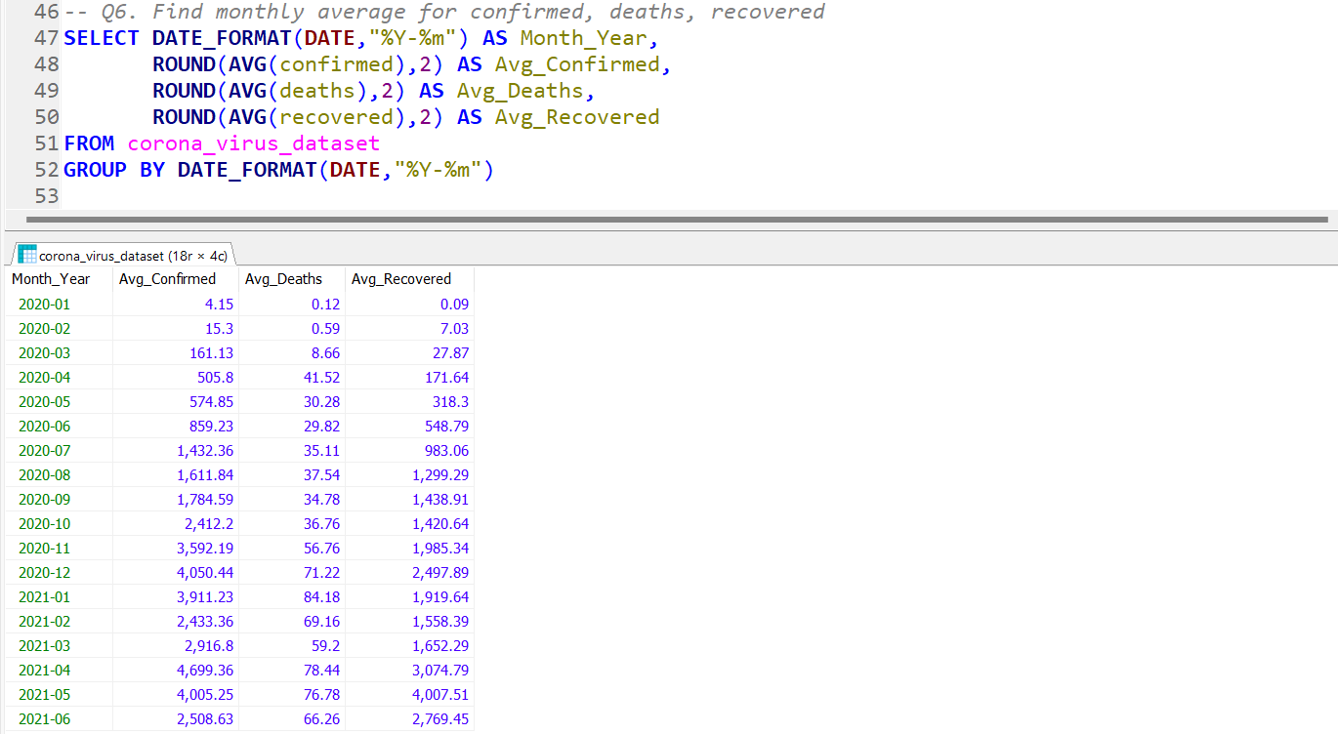
Analysis:-
By using average function it will calculate average confirmed ,recovered and deaths cases in the corona_virus_dataset.
The results are grouped by month, and the avg_confirmed , avg_fatalities and avg_recovered monthly are filtered out. This inquiry facilitates comprehension of the monthly cases average across a 18 months sample period.

Slide 11
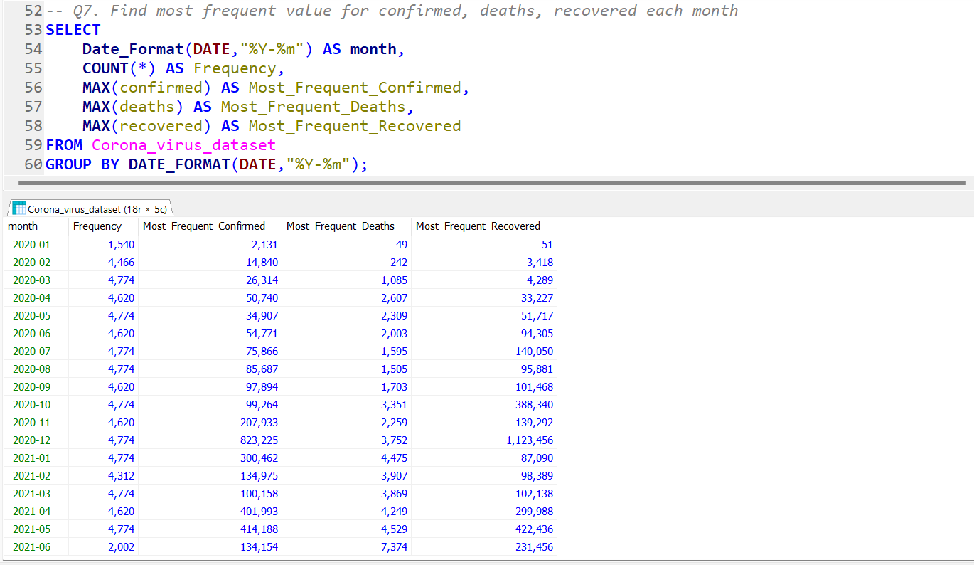
Analysis:-
The goal of the SQL query is to retrieve the most frequent values of corona_virus_dataset table cases that are confirmed,recovered and deaths.
The result are grouped by month, and the most_frequent_confirmed,most_frequent_Deaths and most_frequent_recovered are filtered out. This inquiry facilitates comprehension of the monthly cases that are most frequent across a 18 months sample period.

Slide 12
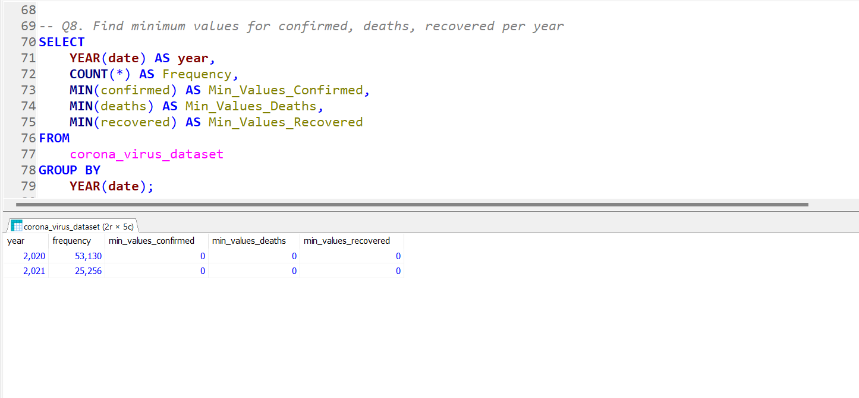
Analysis:-
By using min() function we will retrieve the minimum values for confirmed, deaths and recovered cases present in the corona_virus_dataset table.
The min_values_confirmed,min_values_deaths and min_values_recovered are filtered out after the results are aggregated by year.This inquiry makes the annual cases with minimal values easier to understand.

Slide 13
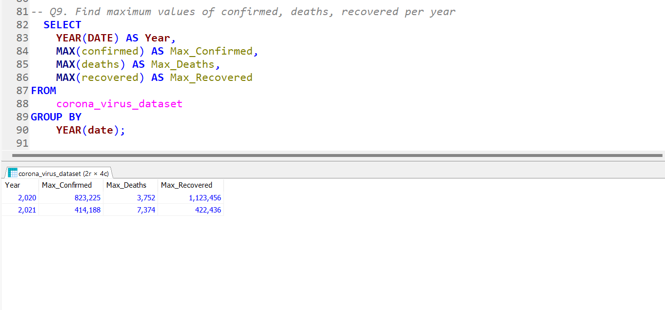
Analysis:-
In this SQL query, maximum values of confirmed , recovered and deaths cases are filtered out from the corona_virus_dataset table.
The outcome are grouped by year, that is extracted from the Date column and then the Max_confirmed , Max_Deaths and Max_Recovered are showcase. This SQL query facilitated the understanding of the annual situations with maximum values.

Slide 14
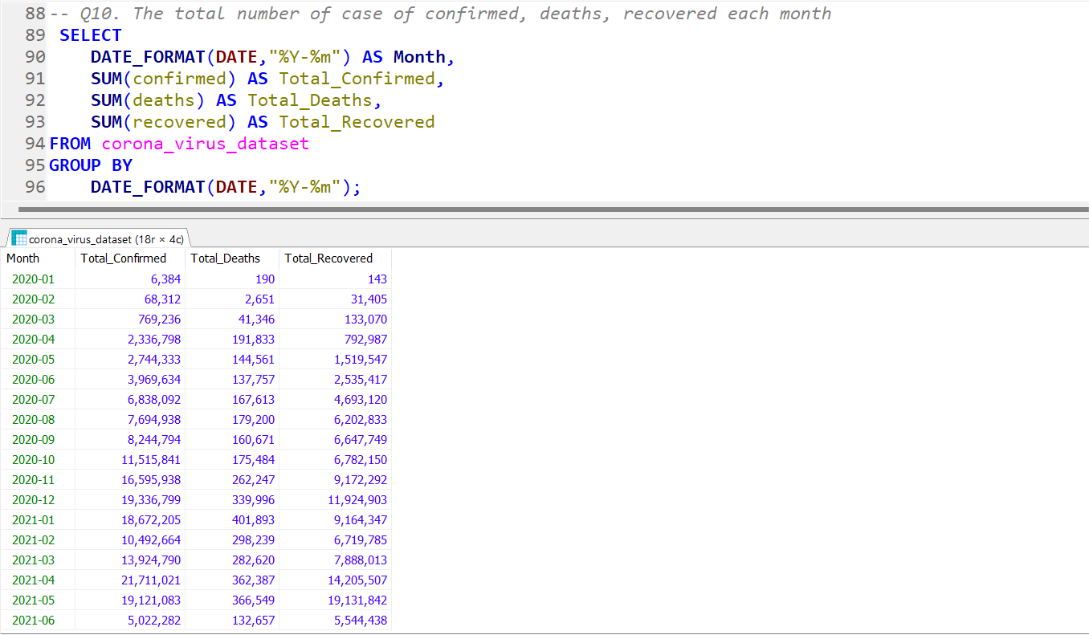
Analysis:-
It utilizes the sum function on confirmed , deaths and recovered and it gives a total number of cases which is a good measure to compare the data.
It then group the calculation by month that is extracted from date column, then it filter out as the Total_Confirmed , Total_Deaths and Total_Recovered cases . This query helps to understand the total number of cases that are present in the 18 months of sample period one-by-one.

Slide 15
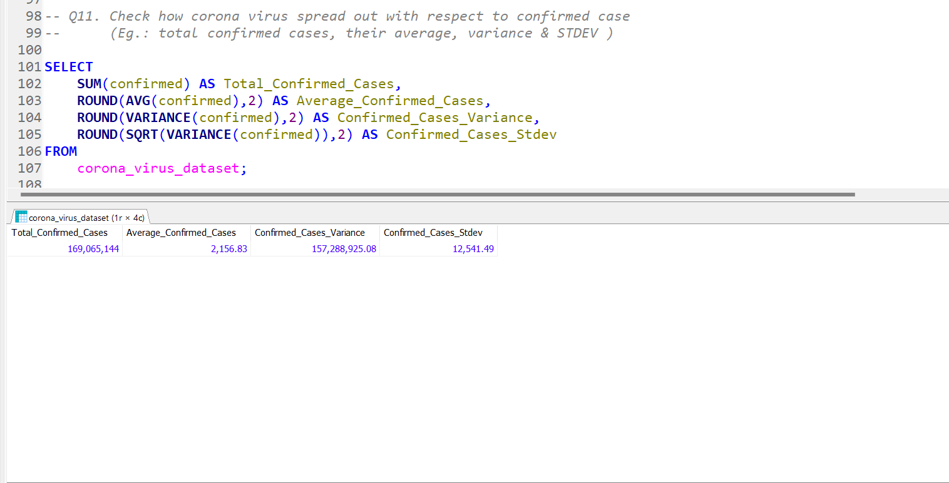
Analysis:-
The Total_confirmed_cases result from the SQL query , which also does statistical calculations such as average , variance and standard deviation . The standard deviation is computed using the SQRT function . We remove the Avg_confirmed_cases , Confirmed_cases_variance and confirmed_cases_stdev from the corona_virus_dataset as a result of this function. This given a clear understanding about the confirmed cases.

Slide 16
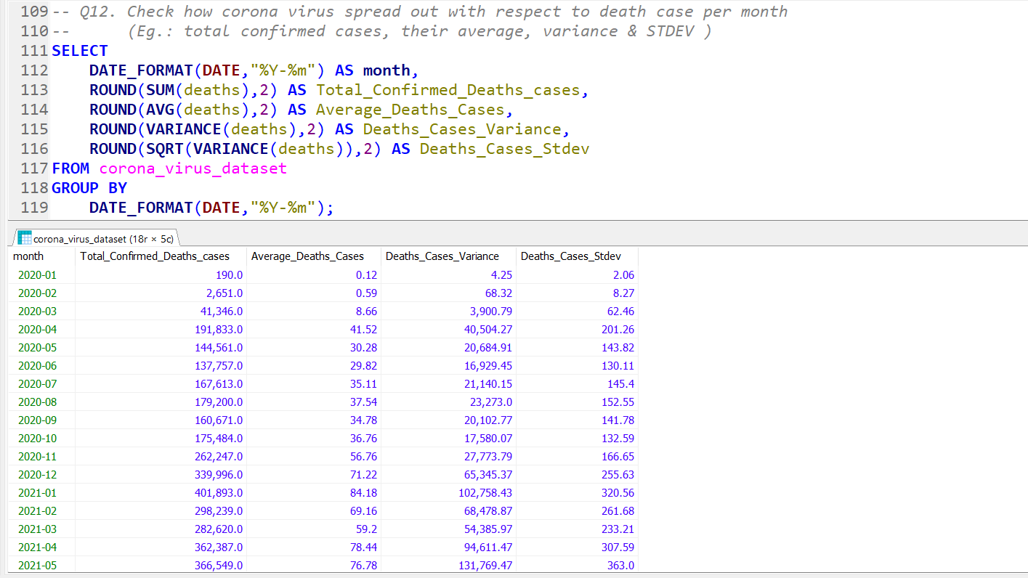
Analysis:-
By using the SUM() , AVG() , VARAINCE() and SQRT() function in the SQL query it will generate a quick overview of the deaths cases in the corona_virus_dataset table.
The results are group by month , then Total_confirmed_death_cases , avg_deaths_cases , Deaths_cases_variance and the deaths_cases_Stdev will be filtered out. This SQL query will help to understand the deaths cases that are occurred in the 18 months of sample period.

Slide 17
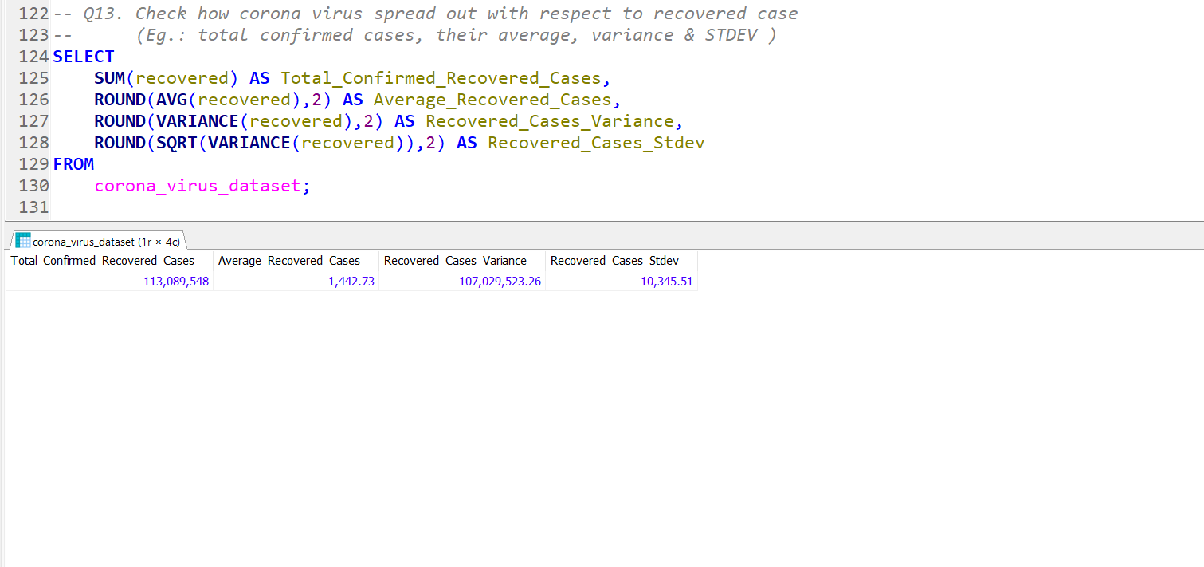
Analysis:-
The Total_confirmed_Recovered_cases result from the SQL query , which also does statistical calculations such as average , variance and standard deviation . The standard deviation is computed using the SQRT function . We remove the Avg_Recovered_cases , Recovered_cases_variance and Recovered_cases_stdev from the corona_virus_dataset as a result of this function. This given a clear understanding about the recovered cases.

Slide 18
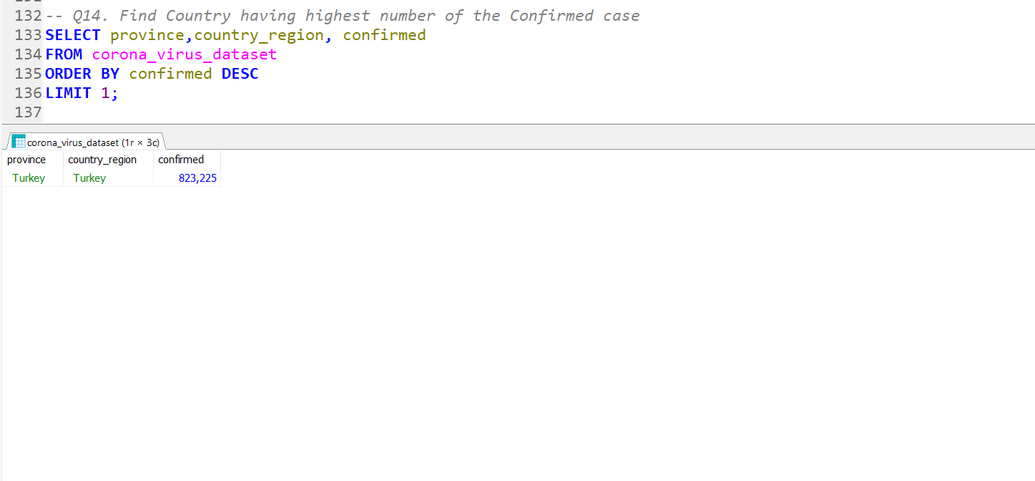
Analysis:-
It displays the country with highest number of confirmed cases in the corona_virus_dataset table. The table has has been arranged in descending order by confirmed column , and a limit of one has been applied to view only the first record of each verified column . Now, it shows Turkey as the country having the most confirmed cases of coronavirus.

Slide 19
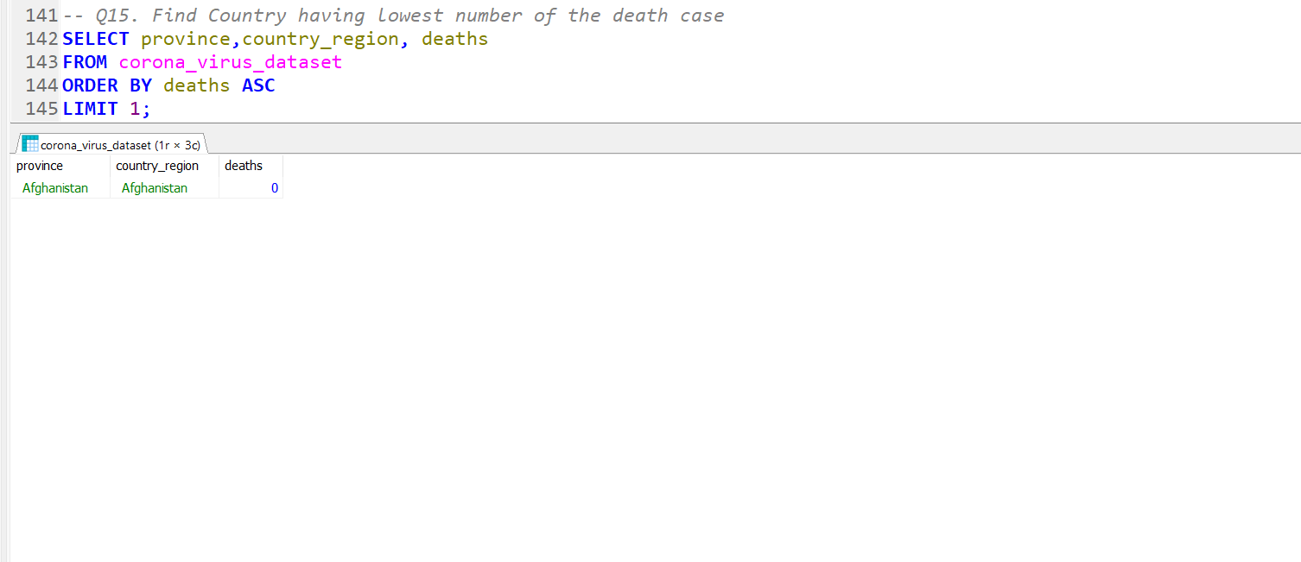
Analysis:-
In the corona_virus_dataset table , it will diplay the country with the lowest number of deaths cases . The table has been arranged in descending order by the death column , and the limit of one has been applied to view only the first verified record in the death column . Now , it shows Afghanistan as the country that have lowest number of death cases.

Slide 20
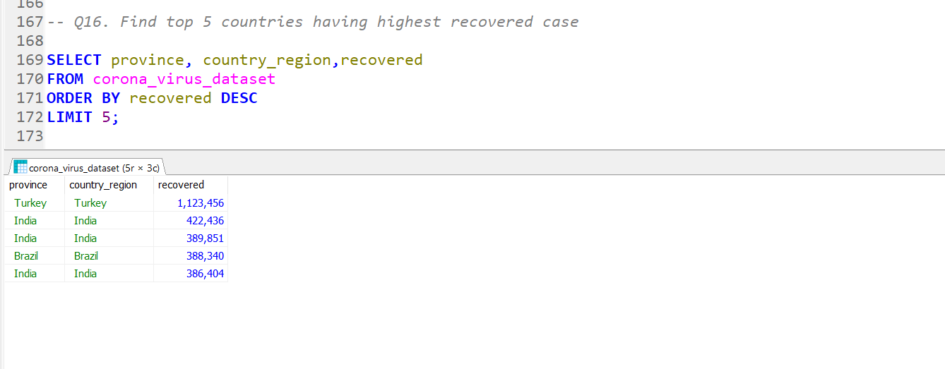
Analysis:-
In the corona_virus_dataset table , it displays the Top 5 countries with the most recovered cases . The table has been arranged in descending order by recovered column , and a 5 limit has been applied to display only the first five records for each recovered column . The result shows the top 5 countries having the most recovered cases . Countries such as India , Brazil and Turkey have the most recovered cases.

Slide 21

SUMMARY
In our coronavirus analysis project, we utilized SQL to examine spread of coronavirus all over the world. The project involved querying a database containing table for coronavirus cases and among other relevant data. To gather comprehensive insights, we employed SQL functions to collect information from the table, such as coronavirus cases with there respective records. These SQL queries enable a comprehensive perspective on cases that exist in different part of the world.
We made use of sql functions and features to enhance our analysis. Aggregate functions like SUM(), AVG(), COUNT() helped us calculate statistics such as average confirmed & recovered cases, total number of cases present & the total count of observations.
Additionally, we made use of other sql functions to enhance our analysis. Functions like MIN(),MAX() to get the country having maximum and minimum number of recovered and death cases. We also use function like VARIANCE(),SQRT() to help us calculate statistics such as variance of death and confirmed cases & standard deviation of deaths and recovered cases.
Overall, our coronavirus analysis project leveraged sql’s powerful capabilities including functions, constraint and other sql features to conduct a comprehensive evaluation of affected and recovered cases. Through careful analysis of the data and strategic application of SQL functions , we were able to derive valuable insights to inform decision-making and optimization strategies within the global environment.

Slide 22


